Slide 1
Fundamentals of Web
By: Ashok Basnet

Slide 2

Course Outline
Introduction to Internet, WWW, Web Browsers, Web Servers, URL, Multipurpose Internet Mail Extensions
Overview of different protocols: HTTP, POP, SMTP, FTP, WAP, Web Architecture, Web Standards
Domain name and hierarchy, domain name registration process, web hosting

Slide 3

1.1 Internet
What is Internet?

Slide 4

Internet
Basically, Internet is a huge collection of computers and other devices connected in a communications network.
The computers and other devices connected in computer network may be of various size, configuration and manufacturer.
These diverse devices and computers communicate with each other with the help of low-level protocol: the TCP (Transmission Control Protocol).
All other higher-level protocol runs on top of TCP

Slide 5
Normally, in an organization, the individual computers in an organization are connected to each other in a local network and one node on this local network is physically connected to the Internet.
So, the Internet is actually a network of networks, rather than a network of computers.
Normally, internet refers to public network.
All devices connected to the Internet must be uniquely identifiable with the help of unique IP address.
Thus, Internet is a global system of interconnected computer networks that use TCP/IP to link devices world-wide. It is a network of networks that consists of private, public, academic, business and academic networks of global to local scope, linked by a broad array of electronic, wireless and optical networking technologies.
Internet carries a vast range of information resources and services, such as inter-linked hypertext documents, and applications of World Wide Web (WWW), electronic mail, telephony and file sharing.

Slide 6
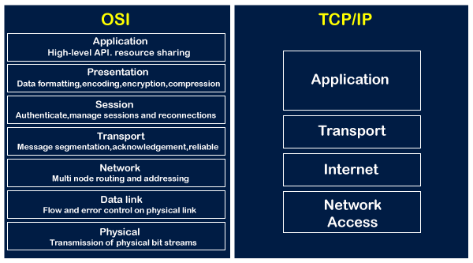

Slide 7
OSI Layer
Physical Layer:
The physical layer is responsible for the transmission of raw bit streams over a physical medium, such as a copper or fiber-optic cable.
E.g. Ethernet, Wi-Fi, fiber optic cables, copper cables
Data Link Layer:
The data link layer provides reliable transmission of data frames between devices on the same network segment, using protocols such as Ethernet or Wi-Fi.
E.g. Ethernet, Wi-Fi, MAC (Media Access Control) addresses, switches, bridges
Network Layer:
The network layer provides logical addressing and routing functions for data packets as they are transmitted between networks, using protocols such as IP (Internet Protocol).
E.g.IP (Internet Protocol), ICMP (Internet Control Message Protocol), routing protocols (e.g. OSPF, BGP)

Slide 8
OSI Layer
Transport Layer:
The transport layer provides reliable, end-to-end data transmission between applications running on different devices, using protocols such as TCP (Transmission Control Protocol) or UDP (User Datagram Protocol).
E.g. TCP (Transmission Control Protocol), UDP (User Datagram Protocol)
Session Layer:
The session layer establishes, manages, and terminates communication sessions between applications on different devices.
E.g. NetBIOS, RPC (Remote Procedure Call)

Slide 9
OSI Layer
Presentation Layer:
The presentation layer is responsible for formatting and presenting data in a way that is meaningful to the applications that use it, including data encryption and compression.
E.g. ASCII, JPEG, MPEG, SSL/TLS (Secure Sockets Layer/Transport Layer Security)
Application Layer:
The application layer provides a means for applications to access network services, using protocols such as HTTP (Hypertext Transfer Protocol), FTP (File Transfer Protocol), and SMTP (Simple Mail Transfer Protocol).
E.g. HTTP (Hypertext Transfer Protocol), FTP (File Transfer Protocol), SMTP (Simple Mail Transfer Protocol), DNS (Domain Name System)

Slide 10
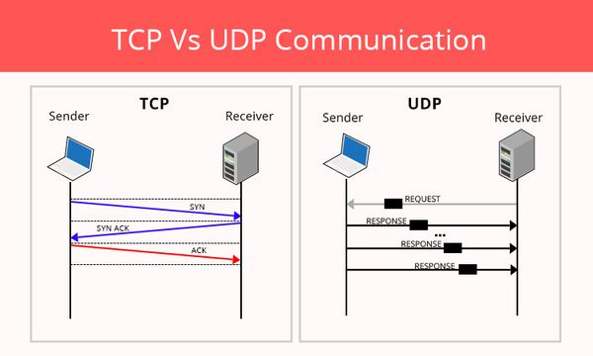

Slide 11
Evolution of Internet:
In the 1960s, for the first time, the U.S. Department of Defense (DoD) developed a new large-scale computer network, known as ARPAnet, which was funded by ARPA (Advanced Research Projects Agency).
ARPAnet was available only to limited laboratories and universities and the great majority of educational institutions were not connected.
So, in late 1970s and early 1980s, other networks like: BITNET (Because It’s Time Network) and CSNET (Computer Science Network) were developed for electronic mail and file transfers. For variety of reasons, these networks weren’t used widely.

Slide 12
Evolution of Internet:
In 1986, a new national network. NSFnet was created, sponsored by NSF (National Science Foundation).
NSFnet was connected to various universities and was available to academic institutions and research laboratories and by 1992, NSFnet connected more than million computers around the world.
In 1995, a small part of NSFnet returned to being a research network.
The rest became known as the Internet, although this term was used much earlier for both ARPAnet and NSFnet.

Slide 13
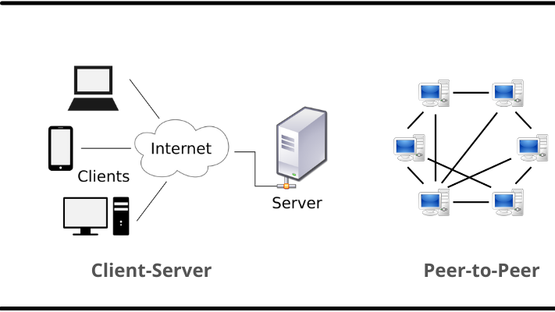

Slide 14
Task 1
Differentiate between Internet, Intranet and Extranet with examples of each.
Explain the essential differences between LAN, WAN, MAN, PAN and Web with possible examples.

Slide 15
World Wide Web (WWW)
In 1989, a small group of people led by Tim Berners-Lee at CERN proposed a new protocol for the Internet, as well as a system of document access to use it which was named as World Wide Web (or simply as “the Web” now )
Originally, it was used to allow scientists around the world to use the Internet to exchange documents describing their work.
The proposed new system was designed to allow a user anywhere on the Internet to search for and retrieve documents from databases on any number of different document-serving computers connected to the Internet
By late 1990, the basic ideas for the new system had been fully developed and implemented on a NeXT computer at CERN

Slide 16
In 1991, the system was ported to other computer platforms and released to the rest of the world.
For the form of its documents, the system used hypertext, which is text with embedded links to text in other documents to allow non sequential browsing of textual material.
The units of information on the Web have been referred to by several different names; like: pages, documents, and resources.
Documents are sometimes just text, usually with embedded links to other documents, but they often also include images, sound recordings, or other kinds of media.
When a document contains non textual information, it is called hypermedia.

Slide 17
Is Internet and Web same?
No, Internet and the Web are not the same thing.
The Internet is a public network of networks which is the collection of computers and other devices connected by equipment that allows them to communicate with each other.
But the Web is a collection of software and protocols that has been installed on most, if not all, of the computers on the Internet.
Some of these computers run Web servers, which provide documents, but most run Web clients, or browsers, which request documents from servers and display them to users.
Normally, we cannot perform live (online) access of Web without internet connection but the Internet was quite useful before the Web was developed, and it is still useful without it.
However, most users of the Internet now use it through the Web.

Slide 18

Web Architecture:
Web Architecture refers to the conceptual structure of web on the internet.
Basically, web architecture controls how the devices and the related applications connected on the internet communicate with each other.
Normally, there are two common types of web architectures: 2-tier architecture (clientserver architecture) and 3-tier architecture.

Slide 19


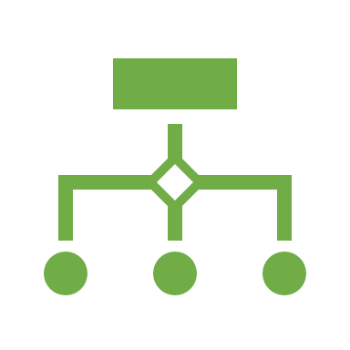
Client-Server Architecture
When two computers communicate over some network, in many cases one acts as a client and the other as a server.
The client (with client application e.g. web browser) initiates the communication, which is often a request for resources i.e. information stored on the server, which then sends that information back to the client.
The Web, as well as many other systems, operates in this client-server configuration.

Slide 20
Client-Server Architecture
Retrieving a website using a URL address that directs to the server to the website in the client’s browser is an example of two-tiered architecture model.
Three prerequisites that must exist in web architecture for distributed application systems to communicate with one another are as follows:
Representation formats with a fixed standard: e.g. HTML and CSS
Protocols for data transfer: e.g. HTTP, SMTP, etc.
The standards for addressing: e.g. URL (Uniform Resource Locator)
The web architecture may also consists of database servers that manage the data and resources.

Slide 21
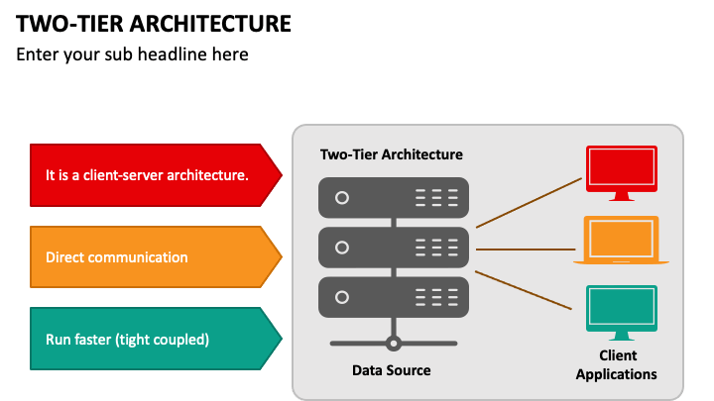

Slide 22
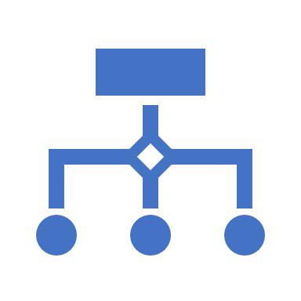



Three-Tiered Architecture
The three-tiered architecture include an application logic between the client and the server, which handles the data processing and allows a certain degree of interaction.
An application server can process data while database server can store data.
Normally, the third-layer with Common-Gateway-Interface (CGI) application is included in most servers to implement three-tiered architecture.
Different programming language and frameworks like- PHP, JSP, ASP.NET etc. implement three-tiered models.

Slide 23
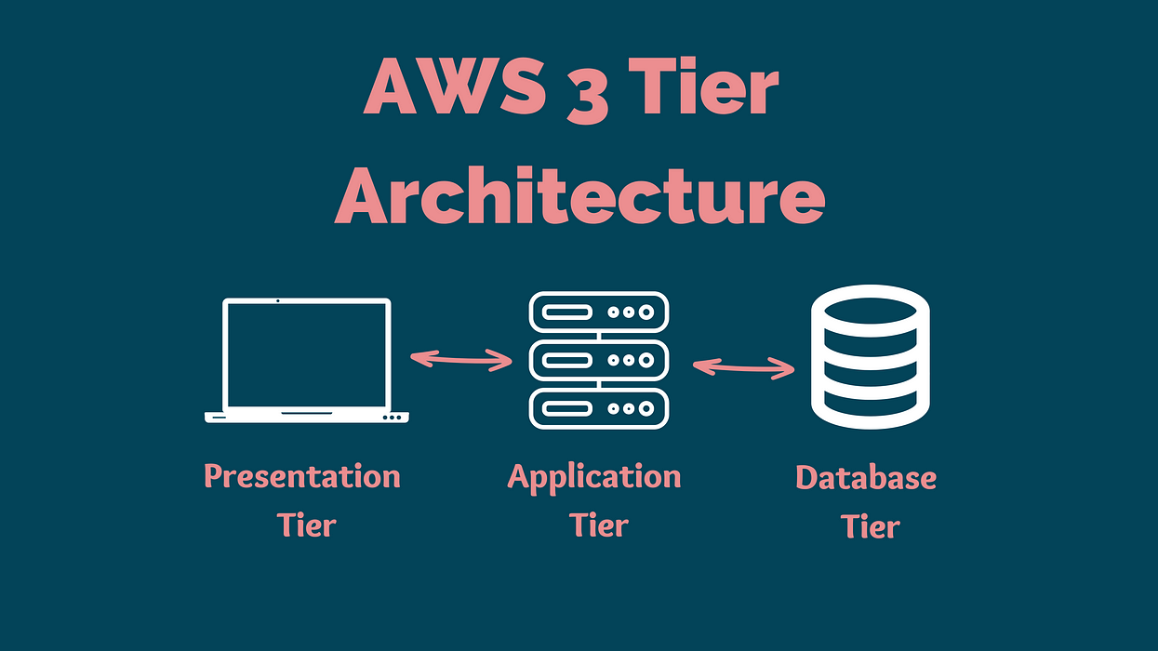

Slide 24
Web Browsers
Web browsers are the applications or the programs running on the client machines that request for the information stored on the server.
In other words, web browser is a software application for retrieving, presenting and traversing information resources on the World-Wide Web.
They are called browsers because they allow the users to browse the resources available on the servers.
The first browsers were text based—they were not capable of displaying graphic information.
In early 1993, the first browser with a graphical user interface was released with the name: Mosaic and versions of Mosaic for Apple Macintosh and Microsoft Windows systems had also been released on the same year.

Slide 25
Finally, users of the computers connected to the Internet around the world had a powerful way to access anything on the Web anywhere in the world.
In a simple case browsers request a static document from the server, and the server locates the document among its servable documents and sends it to the browser, which displays it for the user.
However, during more complicated situations, the server may provide a document that requests input from the user through the browser. After the user supplies the requested input, it is transmitted from the browser to the server, which may use the input to perform some computation and then return a new document to the browser to inform the user of the results of the computation.
Sometimes a browser directly requests the execution of a program stored on the server. The output of the program is then returned to the browser.
The most common protocol the Hypertext Transfer Protocol (HTTP) provides a standard form of communication between browsers and Web servers.
The most commonly used browsers are Microsoft Internet Explorer (IE), Mozilla Firefox, Google Chrome, etc.

Slide 26
Web Servers
Web servers are programs that responses or provide resources to the requesting browsers.
Servers are slave programs: They act only when requests are made to them by browsers running on other computers on the Internet.
The most commonly used Web servers are Apache, which has been implemented for a variety of computer platforms, and Microsoft’s Internet Information Server (IIS), which runs under Windows operating systems.
As of June 2009, there were over 75 million active Web hosts in operation, about 47 percent of which were Apache, about 25 percent of which were IIS, and the remainder of which were spread thinly over a large number of others.

Slide 27
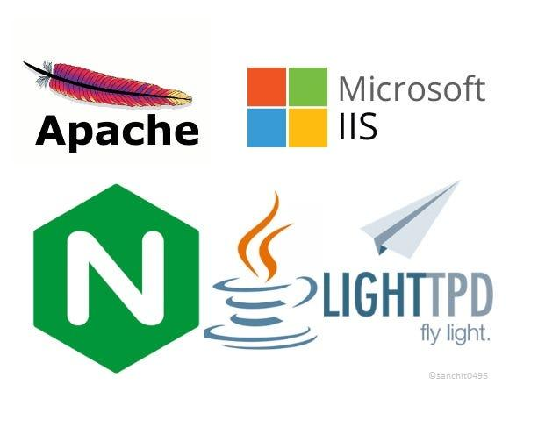

Slide 28
Web Server Operation
Web browsers initiate network communications with servers by sending them URLs.
URL can specify one of two different things: the address of a data file stored on the server that is to be sent to the client, or a program stored on the server that the client wants executed, with the output of the program returned to the client.
All the communications between a Web client and a Web server use the standard Web protocol, Hypertext Transfer Protocol (HTTP).
When a Web server begins execution, it informs the operating system under which it is running that it is now ready to accept incoming network connections through a specific port on the machine.

Slide 29
Cont.
While in this running state, the server runs as a background process in the operating system environment.
A Web client, or browser, opens a network connection to a Web server, sends information requests and possibly data to the server, receives information from the server, and closes the connection.
Of course, other machines exist between browsers and servers on the network-specifically, network routers and domain-name servers.
Thus, the primary task of a Web server is to monitor a communications port on its host machine, accept HTTP commands through that port, and perform the operations specified by the commands.

Slide 30
Task 2
Write short note on:
General Characteristics of Server
Apache Web Server
IIS (Internet Information Server)

Slide 31
Uniform Resource Locators (URL)/Uniform Resource Identifiers (URI)
A URI (Uniform Resource Identifiers) is a string of characters that is used to identify a name or a resource.
It can be further classified as:
URL (Uniform Resource Locators) and
URN (Uniform Resource Name).
The URN is the name of the resource while URL is the address of the resource where it is located.
URN always starts with the prefix urn.
For example:
Urn: sha1:YNCKHTCZO5CTS6HCHGIT3456S (encryption standard)
Urn: isbn: 0-486-27557-4 (to identify the book by its isbn number)

Slide 32
Uniform Resource Locators (URL)
Uniform (or universal) resource locators (URLs) are used to identify documents (resources) on the Internet.
There are many different kinds of resources, identified by different forms of URLs: URL Formats:
All URLs have the same general format: scheme:object-address
The scheme is often a communications protocol. Common schemes include http, ftp, gopher, telnet, file, mailto, and news.
Different schemes use object addresses that have different forms.
HTTP protocol, which supports the Web is used to request and send eXtensible Hypertext Markup Language (XHTML) documents

Slide 33
Uniform Resource Locators (URL)
URL Formats:
In the case of HTTP, the form of the object address of a URL is as follows: //fully-qualified-domain-name/path-to-document
URLs can never have embedded spaces. Also, there is a collection of special characters, including semicolons, colons, and ampersands (&), that cannot appear in a URL.
To include a space or one of the disallowed special characters, the character must be coded as a percent sign (%) followed by the two-digit hexadecimal ASCII code for the character.
For example, if San Jose is a domain name, it must be typed as San%20Jose (20 is the hexadecimal ASCII code for a space).

Slide 34
URL Paths:
The path to the document for the HTTP protocol is similar to a path to a file or directory in the file system of an operating system and is given by a sequence of directory names and a file name, all separated by whatever separator character the operating system uses.
For UNIX servers, the path is specified with forward slashes; for Windows servers, it is specified with backward slashes.
Most browsers allow the user to specify the separators incorrectly—for example, using forward slashes in a path to a document file on a Windows server, as in the following: http://www.gumboco.com/files/f99/storefront.html

Slide 35
URL Paths:
If the specified document is a directory rather than a single document, the directory’s name is followed immediately by a slash, as in the following: http://www.gumboco.com/departments/
Sometimes a directory is specified (with the trailing slash) but its name is not given, as in the following example: http://www.gumboco.com/
The server then searches at the top level of the directory in which servable documents are normally stored for something it recognizes as a home page.
By convention, this page is often a file named index.html.

Slide 36

Multipurpose Internet Mail Extensions (MIME)
Multipurpose Internet Mail Extensions (MIME) is an internet standard that every browser needs to determine the format of a document it receives from a Web server.
By knowing the form of the document, the browser would be able to render it, because different document formats require different rendering tools.
Although MIME was designed mainly to specify the format of different kinds of documents (like- text, video data or sound data) to be sent via Internet mail, but MIME standards are also important in World Wide Web to specify document types transmitted.
A Web server attaches a MIME format specification (i.e. MIME header) at the beginning of the document that it is to provide to a browser.
When the Web Client (i.e. browser) receives the document from the Web Server, it uses the included MIME format specification to determine what to do with the document.

Slide 37
For example- if the content is text, the MIME code tells the browser that it is text and also indicates particular kind of text it is. If the content is sound, the MIME code tells the browser that it is sound and gives the particular representation of sound so that the browser can choose a program to which it has access to produce the transmitted sound.
A list of MIME specifications is stored in the configuration files of every Web server.
Servers determine the type of a document by using the filename’s extension as the key into a table of types.
For example, the extension .html tells the server that is should attach text/html to the document before sending it to the requesting browser.
Browser also maintain conversion table for looking up the type of a document by its file name extension. However, this table is used only when the server does not specify a MIME type.

Slide 38
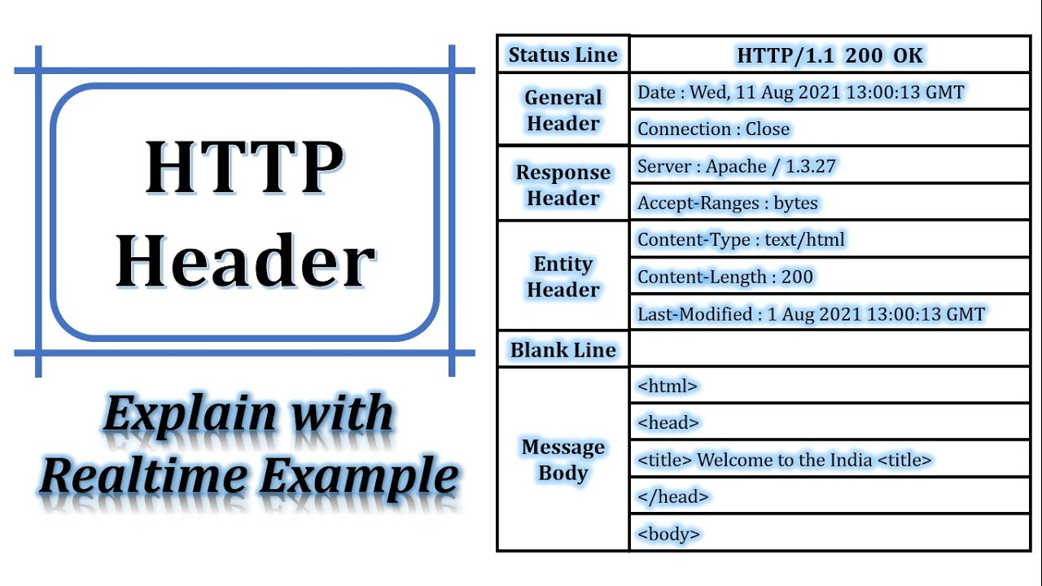

Slide 39
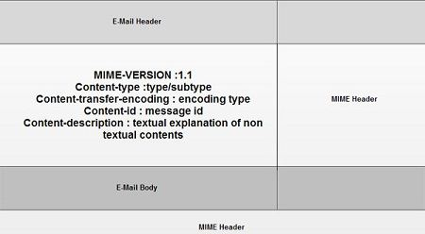

Slide 40
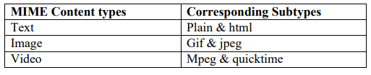
MIME Headers
There are different types of MIME headers which are explained as below:
MIME- Version
Describes the version of the MIME message format
E.g. MIME- Version: 1.0
Content- Type
Describes the MIME content type and subtype
Format: type/subtype, e.g. text/plain, image/jpeg, etc

Slide 41
MIME Headers
Content-Transfer- Encoding
Indicates the encoding method used to transform the document into required bit format for transport
E.g. 7-bit, 8-bit, BASE64, Binary, X-token
Content-ID
Allows a body of information to refer to another.
Content- Description
Possible description for a body of information.

Slide 42

Overview of different Protocols

Slide 43




Hypertext Transfer Protocol (HTTP)
It is an application protocol for distributed, collaborative, and hypermedia information systems.
The Hypertext Transfer Protocol (HTTP) is designed to enable communications between clients and servers i.e. all Web communications transactions use the same protocol: HTTP
HTTP consists of two phases: the request and the response.
Each HTTP communication (request and response) between a browser and a Web server consists of two parts: a header and a body.
The header contains information about the communication, while the body contains the data of the communication if there is any.

Slide 44
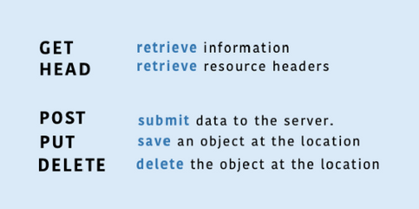
The Request Phase:
The general form of an HTTP request is as follows:
HTTP method Domain part of the URL HTTP version
Header fields
Blank line
Message body
Only a few request methods are defined by HTTP.
GET and POST are the most frequently used methods. POST is now most commonly used to send form data from a browser to a server.

Slide 45
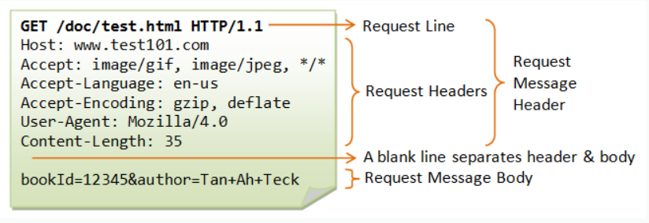
The Request Phase:

Slide 46
The Response Phase
The general form of an HTTP response is as follows:
Status Line
Response header fields
Blank Line
Response body
The status line includes the HTTP version used, a three-digit status code for the response, and a short textual explanation of the status code.
Most common status codes are:
404 Not Found: means the requested file could not be found
200 OK : means the request was handled without error
500 the server encountered a problem : means server was not able to fulfill the request

Slide 47
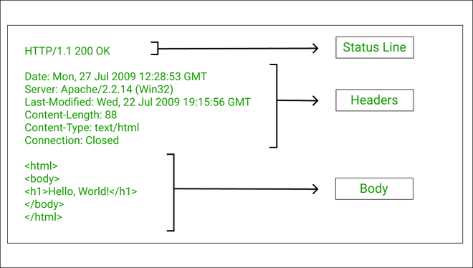

Slide 48
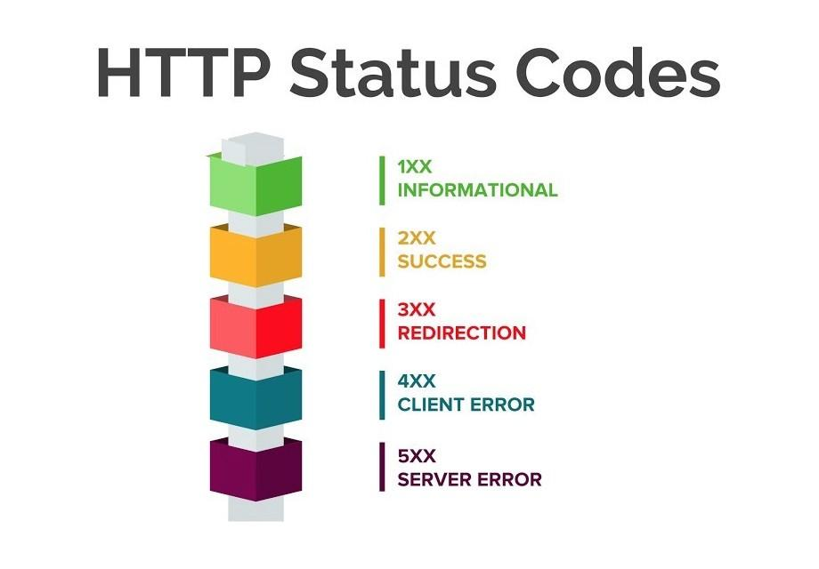

Slide 49

Most common status codes
404 Not Found: means the requested file could not be found
200 OK : means the request was handled without error
500 the server encountered a problem : means server was not able to fulfill the request

Slide 50
Why HTTP is called stateless protocol?
HTTP is stateless protocol which means that a different connection between a client and server is established for each request
HTTP is called as a stateless protocol because each command is request is executed independently, without any knowledge of the requests that were executed before it.
A stateless protocol does not require the server to retain information or status about each user for the duration of multiple requests.
This simplifies the contract between client and server, and in many cases minimizes the amount of data that needs to be transferred. And the Internet is a stateless development environment is often used.

Slide 51
Hypertext Transfer Protocol Secure (HTTPS)
Basically, it is the secure version of HTTP.
It is the protocol where the encrypted HTTP data is transferred over a secure connection.
Communication between the web client (e.g. browser) and the web server are encrypted by Transport Layer Security (TLS) or its predecessor Secure Socket Layer (SSL).
Thus, HTTPS refers to Hypertext Text Transfer Protocol over Secure Socket Layer or HTTP over SSL.
By default, HTTPS uses 443 port, whereas HTTP uses port 80.

Slide 52
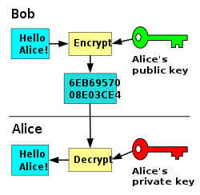

Slide 53

Email Protocols

Slide 54
Post Office Protocol (POP)
It is an application-layer Internet standard protocol used by local e-mail clients to retrieve e-mail from a remote server over a TCP/IP connection.
POP has been developed through several versions, with version 3 (POP3) being the last standard.
POP2 was used in mid-80s and requires SMTP to send messages. POP3 can be used with or without SMTP.
POP supports download-and-delete requirements for access to remote mailboxes.

Slide 55
Although most POP clients have an option to leave mail on server after download, email clients using POP generally connect, retrieve all messages, store them on the user's PC as new messages, delete them from the server, and then disconnect. Thus, POP is like own Post Office box for mail storage.
POP was designed to support “offline” message access but its demerit is that the email gets scattered wherever they access their account.
POP3 server listens on well-known port 110.
POP is important if single user or single device is to access the emails.

Slide 56
Internet Message Access Protocol (IMAP)
It is a mail protocol used for accessing email on a remote web server from a local client.
IMAP Workflow:
Connect to server.
Fetch user content and cache it locally, e.g. list of new mail, message summaries, or content of explicitly selected emails.
Process user edits, e.g. marking email as read, deleting email, etc.
Disconnect.
In IMAP, folder structure and emails are stored on the server and only copies are kept locally. Typically, these local copies are kept temporarily.
Multiple users or clients can manage the same inbox.
Internet connection is needed to access the emails.

Slide 57
Simple Mail Transfer Protocol (SMTP):
SMTP is an application layer TCP/IP protocol used in sending and receiving email to and from email client to a mail server.
Although electronic mail servers and other mail transfer agents use SMTP to send and receive mail messages, user-level client mail applications (e.g. Microsoft Outlook, Apple Mail, etc.) typically use SMTP only for sending message to mail server.
For retrieving messages, client applications usually use either IMAP or POP3.
SMTP communication between mail servers uses TCP port 25 and SMTP port 465 for Secure Transport SSL function enabled.

Slide 58
How SMTP works?
Every email has the sender’s address (e.g. sender@sendermail.com) and the recipient’s in the two field (e.g. recipient@recipientmail.com) and the content of the message.
When an email is sent, the email client connects to the SMTP server of the sender’s email service (e.g. mailserver@sendermail.com)
Now, the SMTP server locates the domain name of the recipient email address i.e. recipientmail.com from the email address (e.g. recipient@recipientmail.com)
Then, the SMTP server contacts the server where the registry is kept (the DNS server).
The DNS server sends back the address to the SMTP server.

Slide 59
The SMTP server then proceeds to hand over the email to the SMTP server of the recipient’s email service (i.e. mailserver.recipientmail.com). This SMTP checks and confirms that the mail addressed to recipient@recipientmail.com belongs to it and hands it over to its counterpart the POP3 server.
If some error occurred to send the email, the emails will be delayed. There is a mail queue in every mail server.
These mails will be pending in the mail queue. The mail server will keep trying to send the resend the email.
Once the email sending fails permanently, the mail server may send a bounce back email message to the sender’s email address.
An SMTP session consists of commands originated by an SMTP client (the initiating agent, sender or transmitter) and corresponding responses from SMTP server (the listening agent or receiver) so that the session is opened, and session parameters are exchanged.
SMTP is used by Mail Transfer Agent (MTA).

Slide 60
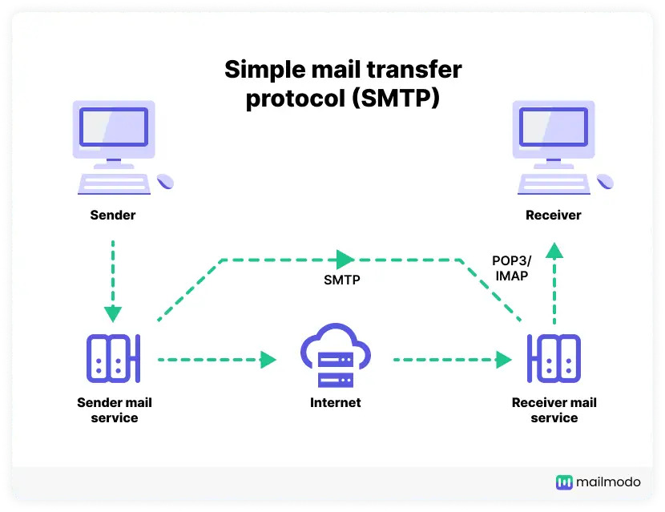

Slide 61
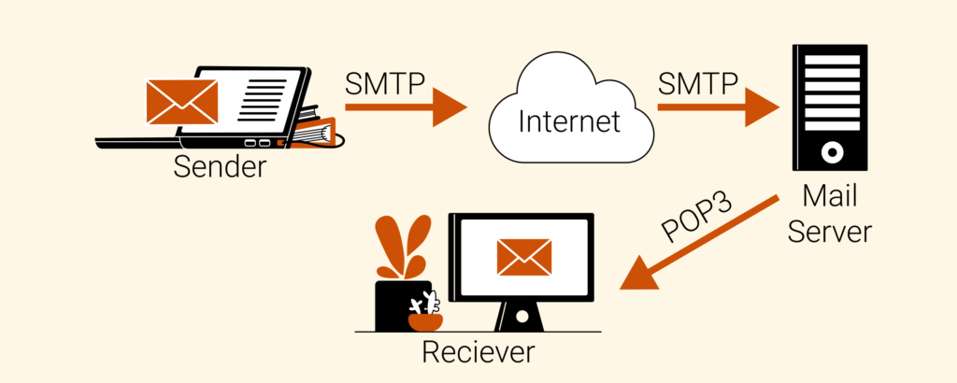

Slide 62
File Transfer Protocol (FTP):
It is a standard network protocol used for the transfer of computer files between a client and server on the internet over TCP/IP connections.
It is a client-server protocol that relies on two communication channels between client and server:
a command channel for controlling the conversation, and
a data channel for transmitting the file content.
Client initiate conversations with servers by requesting to transfer a file

Slide 63
File Transfer Protocol (FTP):
Using FTP, a client can upload, download, delete, and rename, move and copy files on the server.
A user typically needs to login to FTP server with essential details (hostname, username, password, port number and accepting security certificates)
FTP is often secured with SSL/TLS (FTPS), for secure transmission that protects the username and password and encrypts the content.

Slide 64
Wireless Application Protocol (WAP)
WAP is a technical standard for accessing information over a mobile wireless network.
A WAP browser is a browser for mobile devices such as mobile phones that uses this protocol.
WAP supports most wireless networks like- CDMA, GSM, TDMA, etc.
WAP is supported by all operating systems.
WAP browser with small file sizes can accommodate the low memory constraints of handheld devices and low bandwidth constraints of wireless-handheld networks.
The markup language used for WAP is: Wireless Markup Language (WML).
WML uses tags like HTML but syntax is stricter and conforms to XML 1.0 standard.

Slide 65

Web Standards

Slide 66
Web Standards
Web Standards are the rules and guidelines established by the World Wide Web Consortium (W3C) developed to promote consistency in the design code which makes up a web page.
It’s actually the guidelines for markup language which determines how a web page displays in a visitor’s browser window.
The Web Standards define standards for various technologies like- HTML5, CSS/CSS3,SVG (Standard Vectored Graphics), WOFF (Web Open Font Format), the Semantic Web Stack, XML and variety of APIs

Slide 67
Advantages of Using Web Standards
Web Pages will display in wide variety of browsers and computers, i.e. responsive pages by increasing web traffic.
W3C Standards promote the use of Cascading Style Sheets (CSS) or design code which is attached to web page rather than embedded in the page.
The use of CSS significantly reduces the page file size which means not only a faster page loading but lower hosting cost.
Due to use of CSS, instead of editing every individual page, single page can be modified, so lower maintenance cost.
Search Engines are able to access and index pages designed using web standards with greater efficiency.

Slide 68

Domain Name and Hierarchy

Slide 69
Domain Name
A domain name is a unique name for a website. E.g. www.google.com
It is a part of URL that is used to access website.
Domain names must be registered on a server known as Domain Name Server.
When domain names are registered they are added to a large domain name register, and information about registered domain, including its corresponding IP address is stored in DNS Server.

Slide 70
Domain Name System (DNS)
The DNS is an internet based system that consists of Name Server (or Domain Name Server) which is responsible for informing all other devices e.g. computers on the internet about the domain names and corresponding IP address of website.
DNS translates domain names to corresponding IP addresses.
IP address is a numerical data incorporated with 4/6 parts separated by a dot (.).
The numerical value is not easy to remember, so domain names were created which are easily memorable.
Thus, the DNS is a worldwide network that collectively forms a database of domain names and corresponding IP addresses.

Slide 71
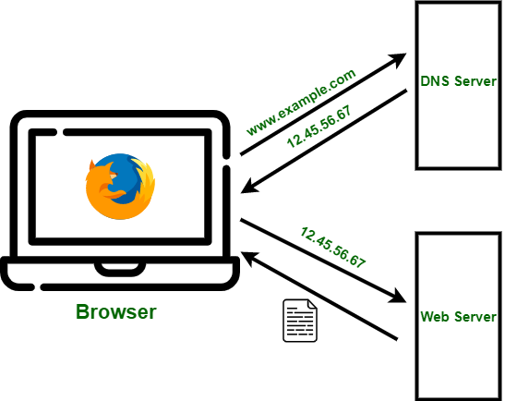

Slide 72
DNS Server
It is a type of web server or software systems included in DNS that is used to interact with Database of domain names and IP addresses.
These servers translate the domain names entered into URL area of web browser to corresponding IP addresses.
All document requests from browsers are routed to the nearest name server. If the name server can convert the fully qualified domain name to an IP address, it does so.
If it cannot, the name server sends the fully qualified domain name to another name server for conversion.
One way to determine the IP address of a Web site is by using telnet on the fully qualified domain name.
Telnet, was developed to allow a user on one computer on the Internet to log onto and use another computer on the Internet.

Slide 73
Fully Qualified Domain Name (FQDN)
A FQDN is the domain name that specifies its exact location in DNS Hierarchy.
It specifies all domain –levels including the top-level domain and the root zone.
Thus, the hostname and all of the domain names are together called a fully qualified domain name.
Like IP addresses, fully qualified domain names must be unique.
It consists of two parts: the host name and the domain name.
An example of FQDN in a mail server is “mail.mydomain.com” where, mail is the host name and mydomain.com is the domain name.

Slide 74
DNS Hierarchy
The DNS Hierarchy is comprised of the following elements:
Root Level,
Top-level Domain,
Second-level Domain,
Sub-domain, and
Host

Slide 75
DNS Root Zone (or, Root Level):
It is the highest level in the DNS Hierarchy Tree.
The root name server is the name server for the root zone that answers the requests by providing a list of authoritative name servers for the appropriate Top-level-domains (TLDs).
DNS root zone is nameless.
These servers contain the global-list of the Top-Level-Domains.
The root zone contain the following hierarchies:
Organizational Hierarchy e.g. .com, .net, .org, etc.
Geographic Hierarchy e.g. .np, .au, .in, etc.

Slide 76
The root DNS servers are operated by 12 different organizations: Verisign, University of Southern California, Cogent, University of Maryland, NASA AMES Research Center, Internet Systems Consortium, US Department of Defense, US Army Research Lab, Netnod, RIPE, ICANN (Internet Corporation for Assigned Names & Numbers ), WIDE

Slide 77

Top-Level-Domains (TLDs)
It is the first-level set of domain-names.
There are many TLDs available.
TLDs are classified into two sub-categories:
Organizational Hierarchy, and
Geographic Hierarchy.

Slide 78
Organizational Hierarchy (generic TLDs or gTLDs)
.com = Commercial Organizations
.edu = Educational Institutions
.gov = Government Organizations
.mil = Military Groups
.net = Major network support centers
.org = Non-profit organizations
.int = International Organizations

Slide 79
Geographic Hierarchy (country code TLDs or ccTLDs)
In geographic hierarchy, each country is assigned with two letter codes. e.g. .np for Nepal, .in for India, etc.
Sometimes the organizational hierarchy are combined with geographic hierarchy to generate the single TLD, e.g. .edu.np (for educational institutions in Nepal), etc.

Slide 80
Second-level Domains
This is the part of the domain that is directly below the Top-level-domain.
This is the main part of the domain name and can vary according to the buyer.
Once the second-level domain name is available under the required TLD, anyone can purchase it for their use.
E.g. in www.google.com, google is a Second-Level-Domain.

Slide 81
Sub-domain
It can be defined as the domain that is a part of the main domain (i.e. second-leveldomain)
Suppose in the two domains: www.one.example.com and www.two.example.com, both the domains are the sub-domains of the main domain www.example.com
Complete Example:
e.g. URL: http://www.example.net/index.html here,
Top-level-domain: .net
Second-level domain : example
Host name: www
Note: A domain name may point to multiple IP addresses to provide server redundancy for the services offered.

Slide 82
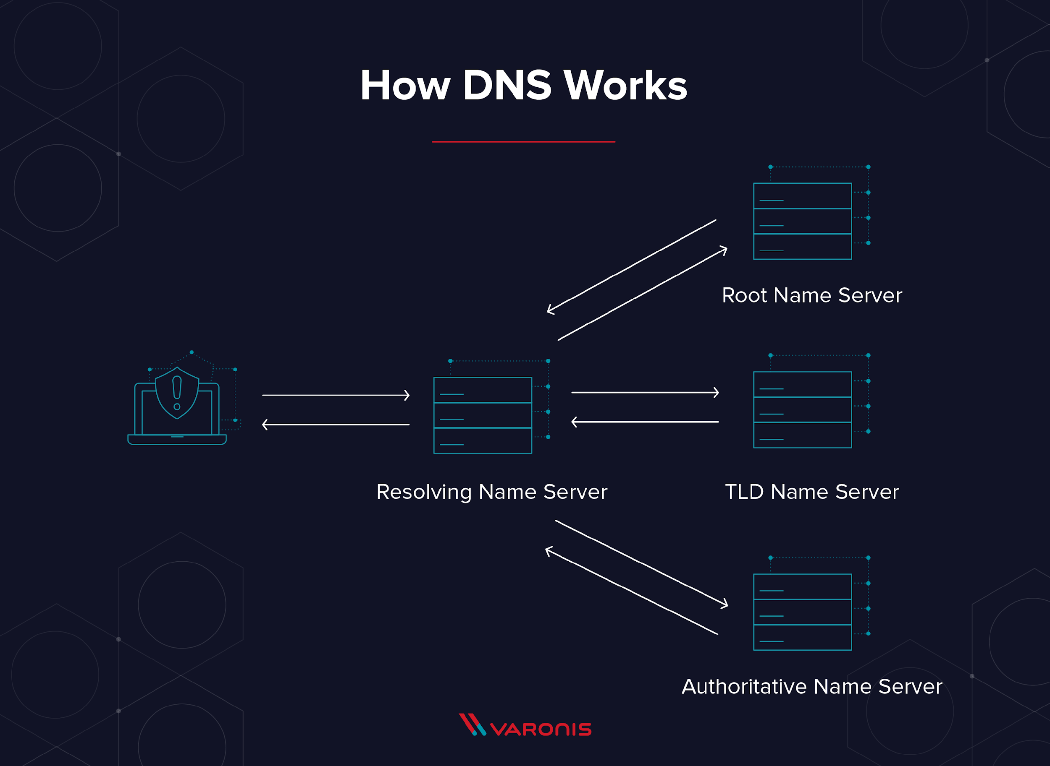

Slide 83
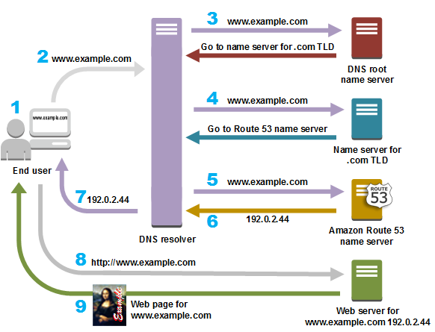

Slide 84
Assignment
Differentiate between:
URL and URI and
SMTP and POP3
What are the series of steps that happen when a URL is requested from the address field of a browser of internet connected computer? Illustrate with suitable figure.

Slide 85

Domain Name Registration Process
First of all, we need to check for desired domain name on whois.net.
After we have chosen a suitable domain name after verifying the availability of desired domain name, we need to submit the domain name registration request to a registrar. (e.g. GoDaddy, Bluehost, Namecheap, Hostgator,etc).
Normally, we need to submit the following information to the registrar:
The desired domain name,
The name and contact information (including, email address, physical address, contact phone number and so on) for the domain registrant, administrative and billing contacts.
The desired domain registration terms,
Payment information.

Slide 86
Once we have provided all these information to the registrar, then we will initiate the domain name registration process for us.
The registrar will send our domain name request and the contact and technical information of the domain name to the registry.
The registry files the contact information for whois.
The registry also adds the domain zone files to the master servers.
The master server tells other servers on the Internet where our website is stored.
Now, the domain is considered to be registered and ready-to-use, when all the information has been updated.

Slide 87

Registrars
Registrars are the organizations accredited by ICANN and certified by the registries to sell domain names.
They are bounded by Registrar Accreditation Agreement (RAA) with ICANN and by their agreements with the registries.
E.g. godaddy, bluehost, etc.

Slide 88
Registry
Registries are responsible for maintaining the registry for each TLD.
The responsibilities of registries including accepting registration requests (whether from registrars or directly form domain name registrants), maintaining a database of the necessary domain name registration data and providing name servers to publish the zone file data (i.e. information about the location of domain name) throughout the internet.
E.g. aaa, apple, etc

Slide 89
Web Hosting
It is a service that allows organizations and individuals to post a website or web applications onto the internet, accessible via World Wide Web.
Websites files are hosted or stored on special computers called web servers.
Web hosts are companies that provide space on a server owned or leased for use for clients, as well as providing Internet Connectivity, typically in a data center.
Web Hosts can provide data center space and other desired features as per the hosting plan.

Slide 90
Types of Web Hosting
Smaller Hosting Services:
It is a small-scale file hosting service, where files can be uploaded via FTP or Web Interface.
Many ISPs offer this service free to subscriber.
Larger Hosting Services:
Many large companies that may not be ISPs need to permanently connected to web to send emails, files,etc to other sites.
Support database, and other application development platforms e.g. PHP, ASP.NET, CMS,SSL, etc.

Slide 91
Types of Larger Hosting Services
Dedicated Web Hosting Services,
Shared Web Hosting Services,
Reseller Web Hosting Services,
Cloud Hosting Services,
Video Hosting Services,
Email Hosting Services,etc

Slide 92
To estimate Web Hosting needs, we need to consider about the following configurations:
Disk Space: amount of data we can store on web server.
Bandwidth: amount of data we are allowed to transfer to and from our web server per month, including all uploads and downloads.
Types of Servers (Apache, IIS, etc)
Operating System (Linux, Windows, etc)
Price, etc.

Slide 93

Thank you

